Slide 1

Preliminary Health Assessment
South Portland Air Quality
Andrew Smith, SM, ScD
State Toxicologist
Environmental and Occupational Health Program
Maine Center for Disease Control and Prevention
November 26, 2019

Slide 2
Road Map
Provide background information
Evaluation of “Grab sample” results
Evaluation of 24-hour sample results
Evaluation of air levels averaged over time
Describe future evaluation of data on asthma-related emergency department visits
Maine CDC - 2

Slide 3
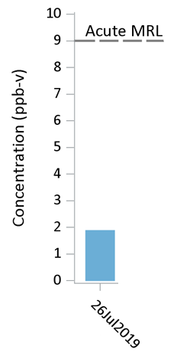
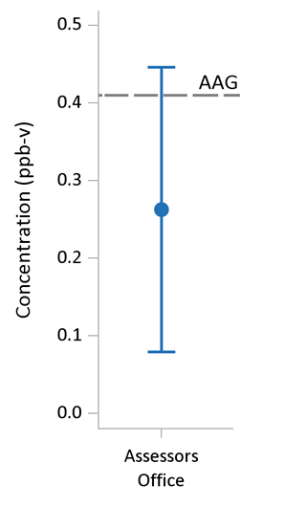
Some Background
Inspection of Air Quality Results and Comparison to Health-based Guidelines
Health-based Guideline
Health-based Guideline
Maine CDC - 3

Slide 4
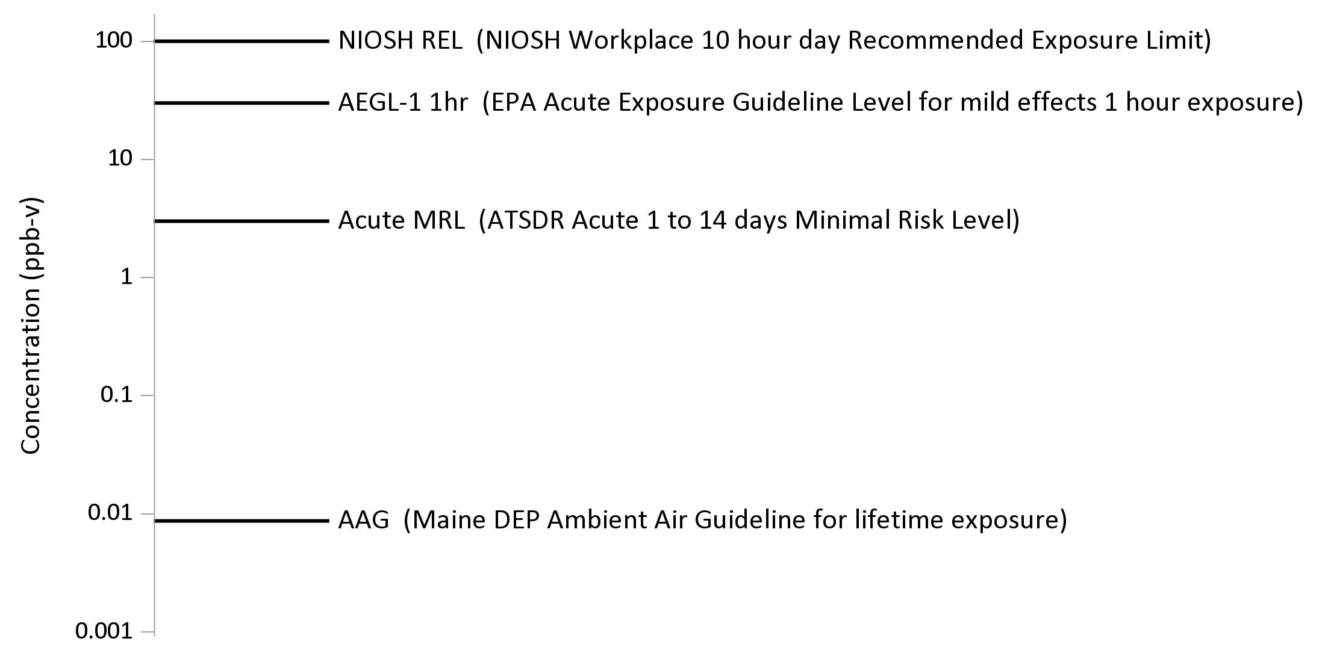
Example: Health-based Exposure Guidelines for Acrolein
EXAMPLE – Exposure Guidelines for Acrolein
Maine CDC - 4
Notes:
Point out that not all chemicals have all these guidelines.

Slide 5
Focus Presentation on Three Chemicals
Benzene, Naphthalene, Acrolein
Three that come closest to exceeding health-based guidelines
Maine CDC - 5
Notes:
Benzene, 6-C and 6-H. Aromatic. Constituent of gasoline. Known human carcinogen (leukemia in workers). Odor threshold > 1000 ppb.
Naphthalene, 10-C and 8-8. Simplest polycyclic aromatic hydrocarbon – looks like two connected benzene rings. Probably best known as a major ingredient of mothballs and used in some deodorant cakes. Possible human carcinogen based on animal studies. Odor threshold as low at 80 ppb.
Acrolein, 3-C, 4-H, 1-O. Aldehyde – family of VOCs that includes formaldehyde . Byproduct of combustion of fuels, wood, etc. The smell of burnt fat when cooking is in partly due to formation of acrolein. Considered a potent respiratory irritant. Odor threshold around 160 ppb.

Slide 6
How we assess short-term exposure to chemicals in outside air:
ATSDR Acute MRLs
EPA AEGLs
For each grab sample…
For each chemical….
Grab 1
Grab 2
Grab 3
Grab 4
Grab 5
Grab #
Grab #
Grab 55
Acrolein
Above a
Short-term Health Guideline
?
Benzene
Naphthalene
1,3-butadiene
Carbon tetrachloride
Chloroform
others
Maine CDC - 6

Slide 7
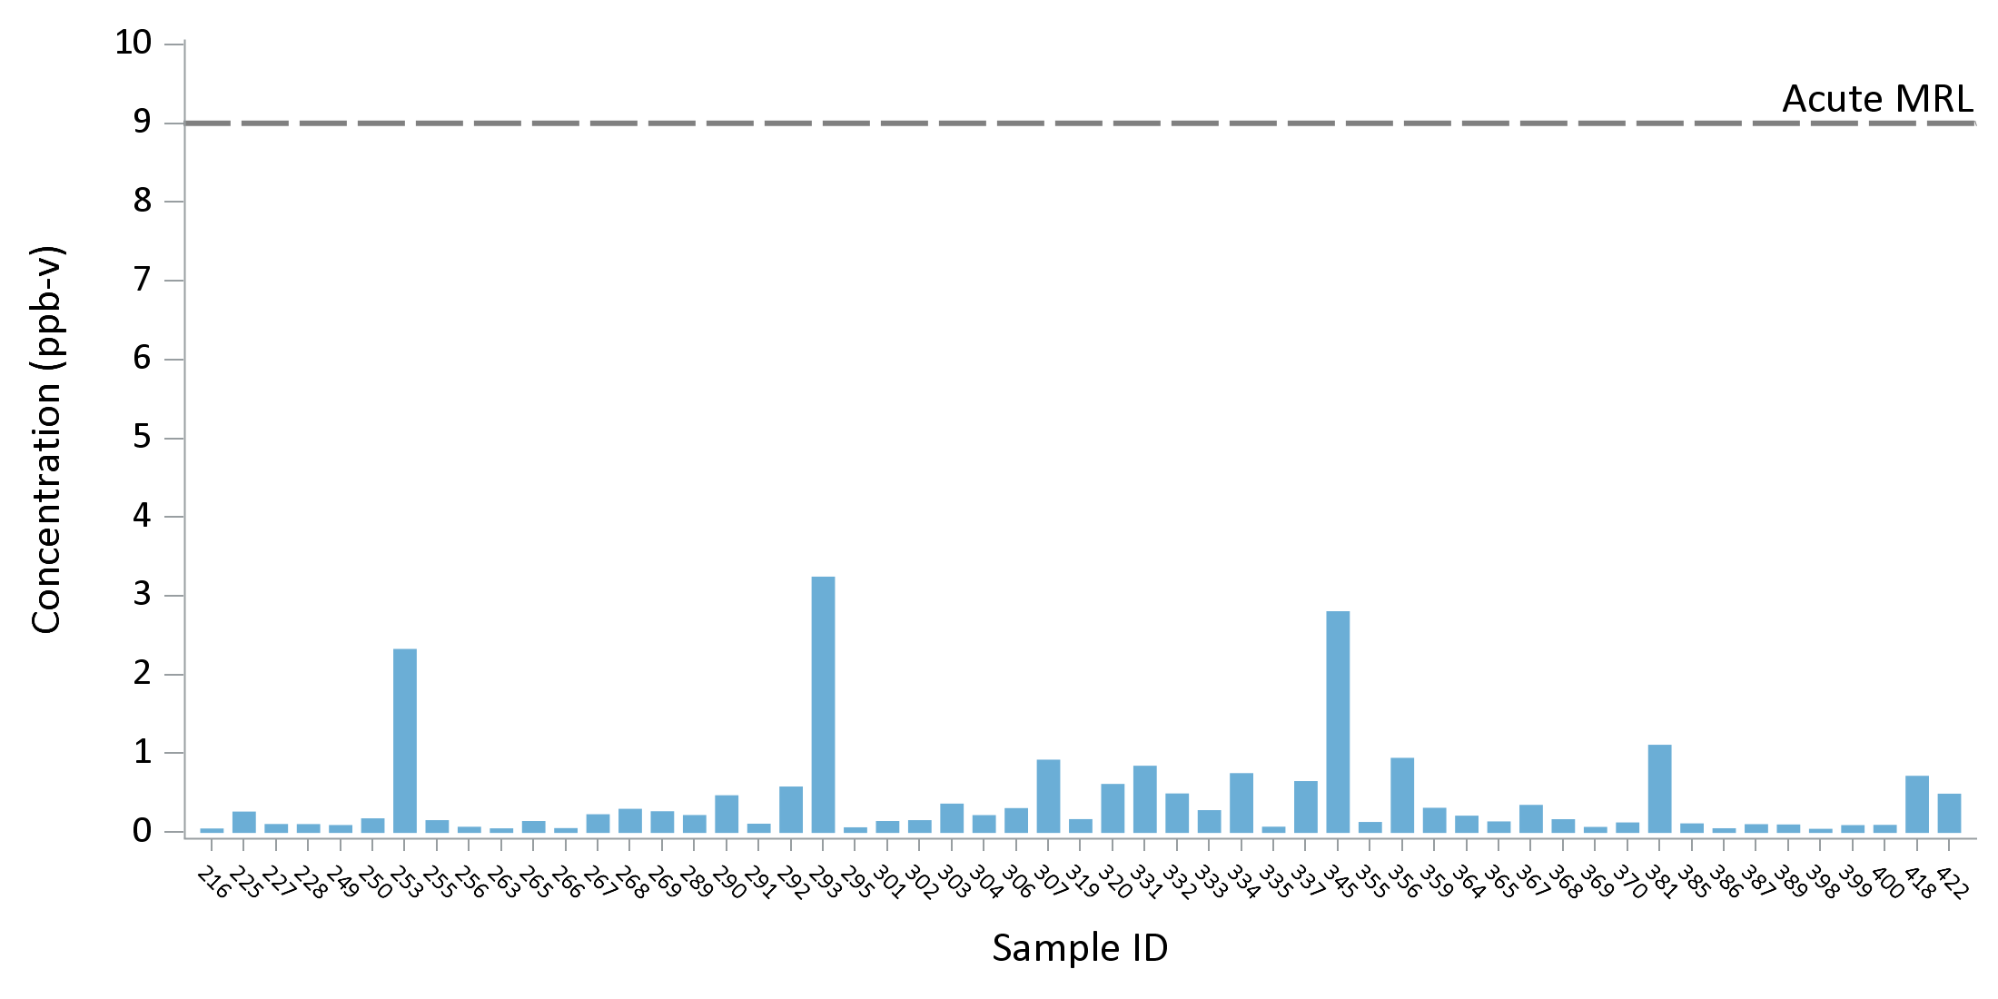
EXAMPLE - Benzene
Comparison of grab sample results for Benzene to an acute health guideline
Maine CDC - 7

Slide 8
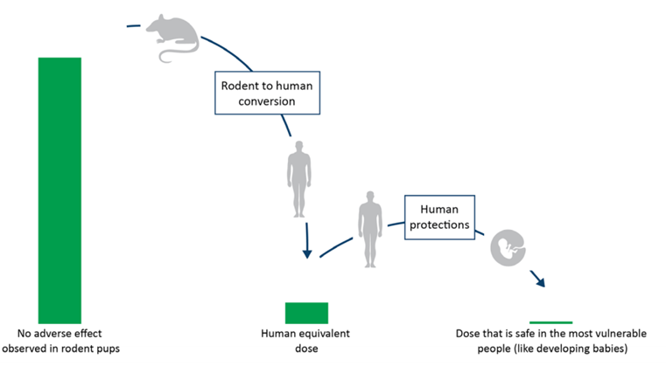

ATSDR’s Derivation of an Acute Toxicity Value for Benzene
10,200 ppb
Rodent to Human,
LOAEL to NOAEL Conversions
Protection of Sensitive Individuals
85 ppb
9 ppb
Decreased Immune Cell Activity (LOAEL)
Human Equivalent Dose (NOAEL)
Dose that is “safe” for sensitive members of the population
~120x
~10x
Maine CDC - 8
Notes:
Male C57BL/6J mice (7–8/group) were exposed to benzene (0, 10.2, 31, 100, or 301 ppm) in whole-body dynamic inhalation chambers for 6 hours/day for 6 consecutive days. The 10.2 ppm exposure level resulted in significant depression of femoral lipopolysaccharide-induced B-colony-forming ability in the absence of a significant depression of total numbers of B cells.. Adjust by 6/24 to make a full day exposure. Adjust 10x for LOAEL to NOAEL, and 3x for animal to human. 10x for average to sensitive human.

Slide 9
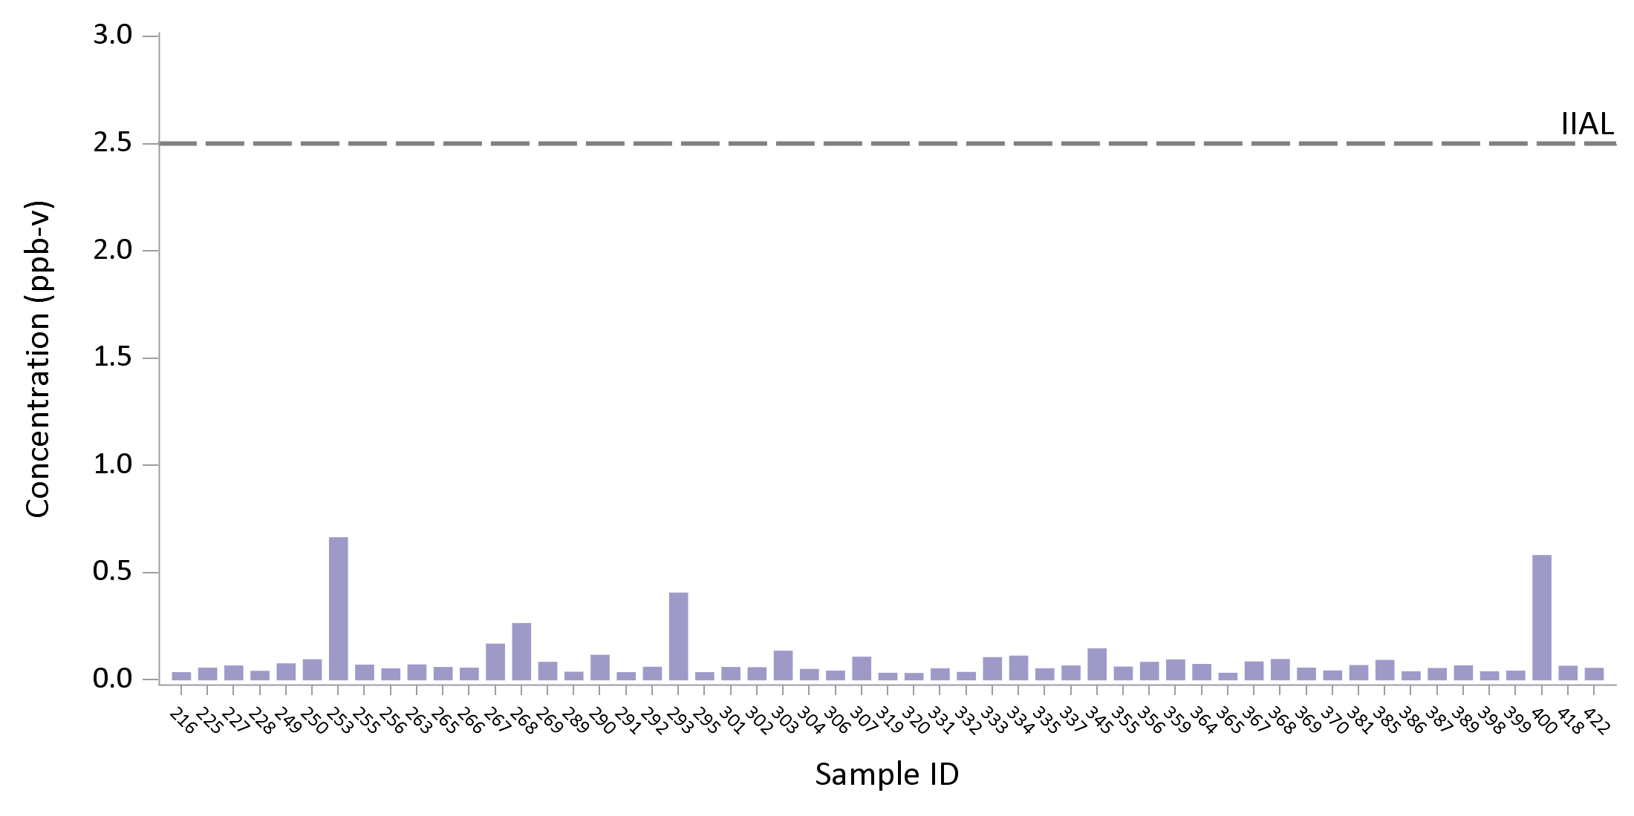
EXAMPLE - Naphthalene
Comparison of grab sample results for Naphthalene to an acute health guideline
Maine CDC - 9

Slide 10
Maine Derivation of an Acute Toxicity Value for Naphthalene
1,500 ppb
Rodent to Human
Conversions
Protection of Sensitive Individuals
25 ppb
2.5 ppb
Nasal lesions
(NOAEL)
Human Equivalent Dose (NOAEL)
Dose that is “safe” for sensitive members of the population
~60x
~10x
Maine CDC - 10
Notes:
Mice were exposed to 7.9 mg/m³ or 79 mg/m³ for 4 hours and assessed for nasal and lung pathology 24 hours post-exposures (Phiminster et al., 2004). Severe Clara cell and olfactory epithelial damage were noted in animals following the inhalation of 79 mg/m³. The Phiminster et al. 2004 study is selected as the most relevant for development of an acute Immediate Intervention Action Level since the lowest exposure concentration and the most sensitive biological effect in rodents were selected for investigation. The NOAEL, adjusted for duration (NOAEL_{adj} = 7.9 mg/m³ x 4 hours/24 hours = 1.32 mg/m³), is used to derive the action level as follows:
Action Level = NOAEL_{adj} ÷ UF of 10 (animal-to-human) ÷ UF of 10 (sensitive human)
= 1,320 ug/m³ ÷ UF (100)
= 13.2 ug/m³ (~10 ug/m³)

Slide 11
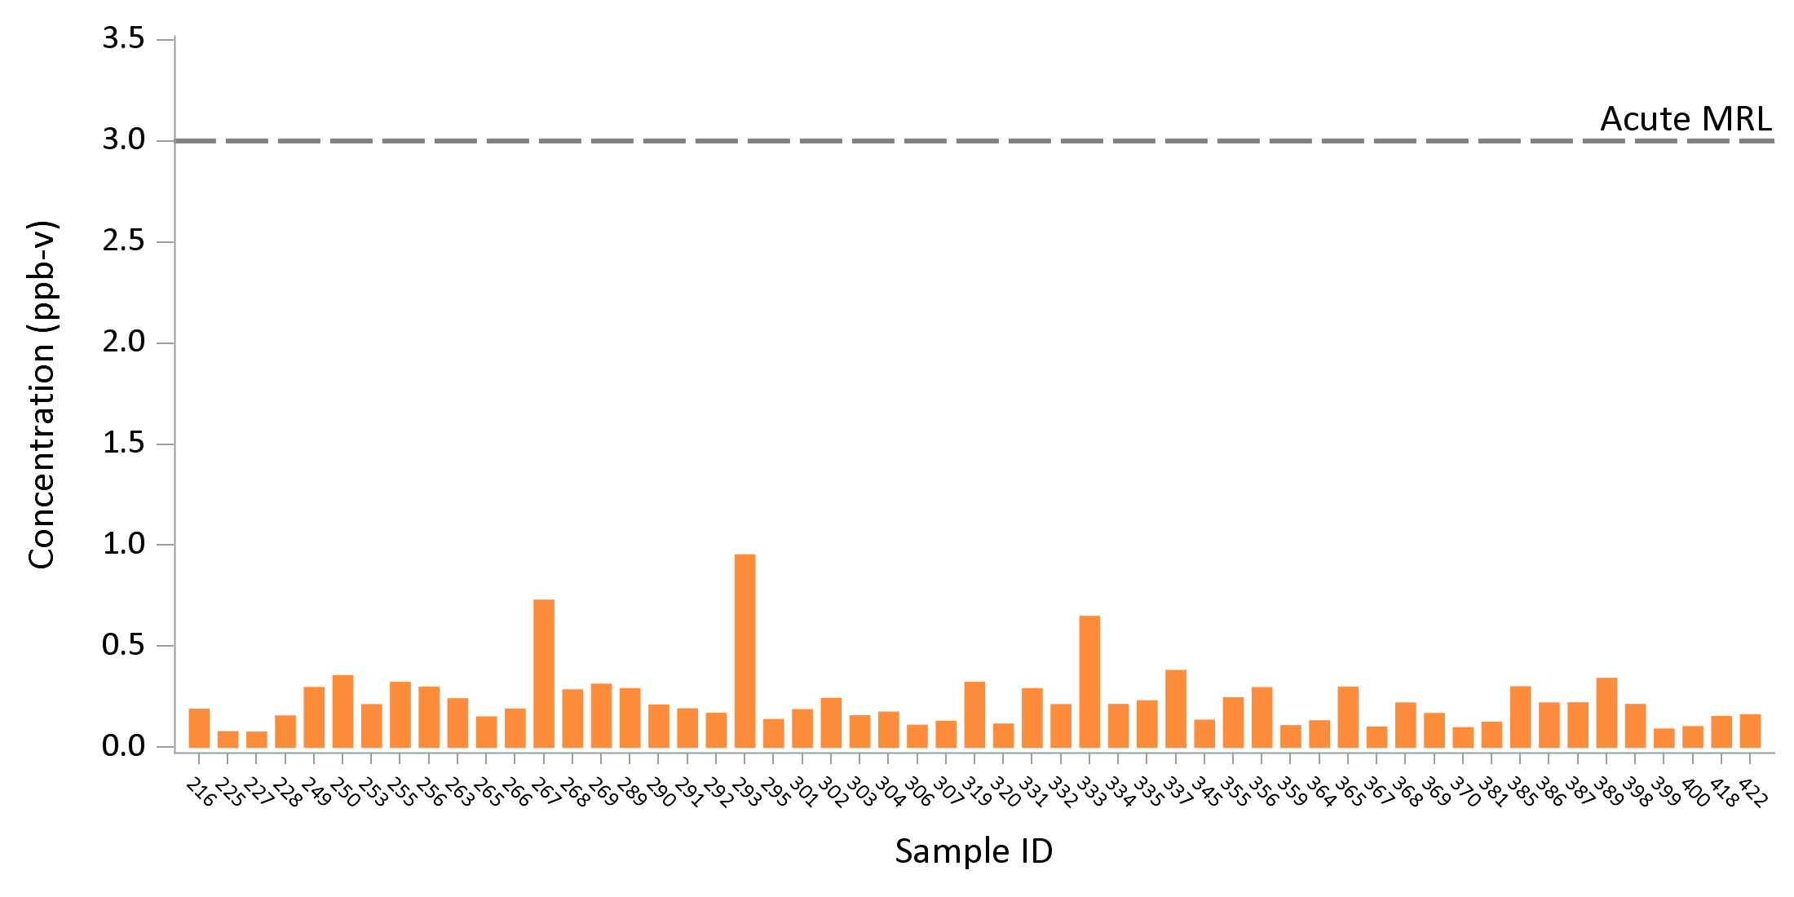
EXAMPLE - Acrolein
Comparison of grab sample results for Acrolein to an acute health guideline
Maine CDC - 11

Slide 12

ATSDR’s Derivation of an Acute Toxicity Value for Acrolein
300 ppb
LOAEL to NOAEL conversion
Protection of Sensitive Individuals
30 ppb
3 ppb
Nose, throat irritation,
decreased breathing rate
(LOAEL)
Estimated no observable adverse effect level (NOAEL)
Dose that is “safe” for sensitive members of the population
10x
10x
Maine CDC - 12
Notes:
Forty-six volunteers (21 men, 25 women) were placed into an exposure chamber in groups of 3 and exposed to 0.3 ppm acrolein for 60 minutes. LOAEL of 0.3 ppm; decrease in respiratory rate, nose and throat irritation. 10x for LOAEL to NOAEL, 10x for average to sensitive human.

Slide 13
How we assess short-term exposure to chemicals in outside air:
ATSDR Acute MRLs
EPA AEGLs
For each location and each 24-hour sampling event…
For each chemical….
Day 1 → 24-hr sample
Day 6 → 24-hr sample
Day 12 → 24-hr sample
Day 18 → 24-hr sample
Day 24 → 24-hr sample
Day 30 → 24-hr sample
Day 36 → 24-hr sample
Acrolein
Above a
Acute Health Guideline
?
Benzene
Naphthalene
1,3-butadiene
Carbon tetrachloride
Chloroform
others
Maine CDC - 13

Slide 14
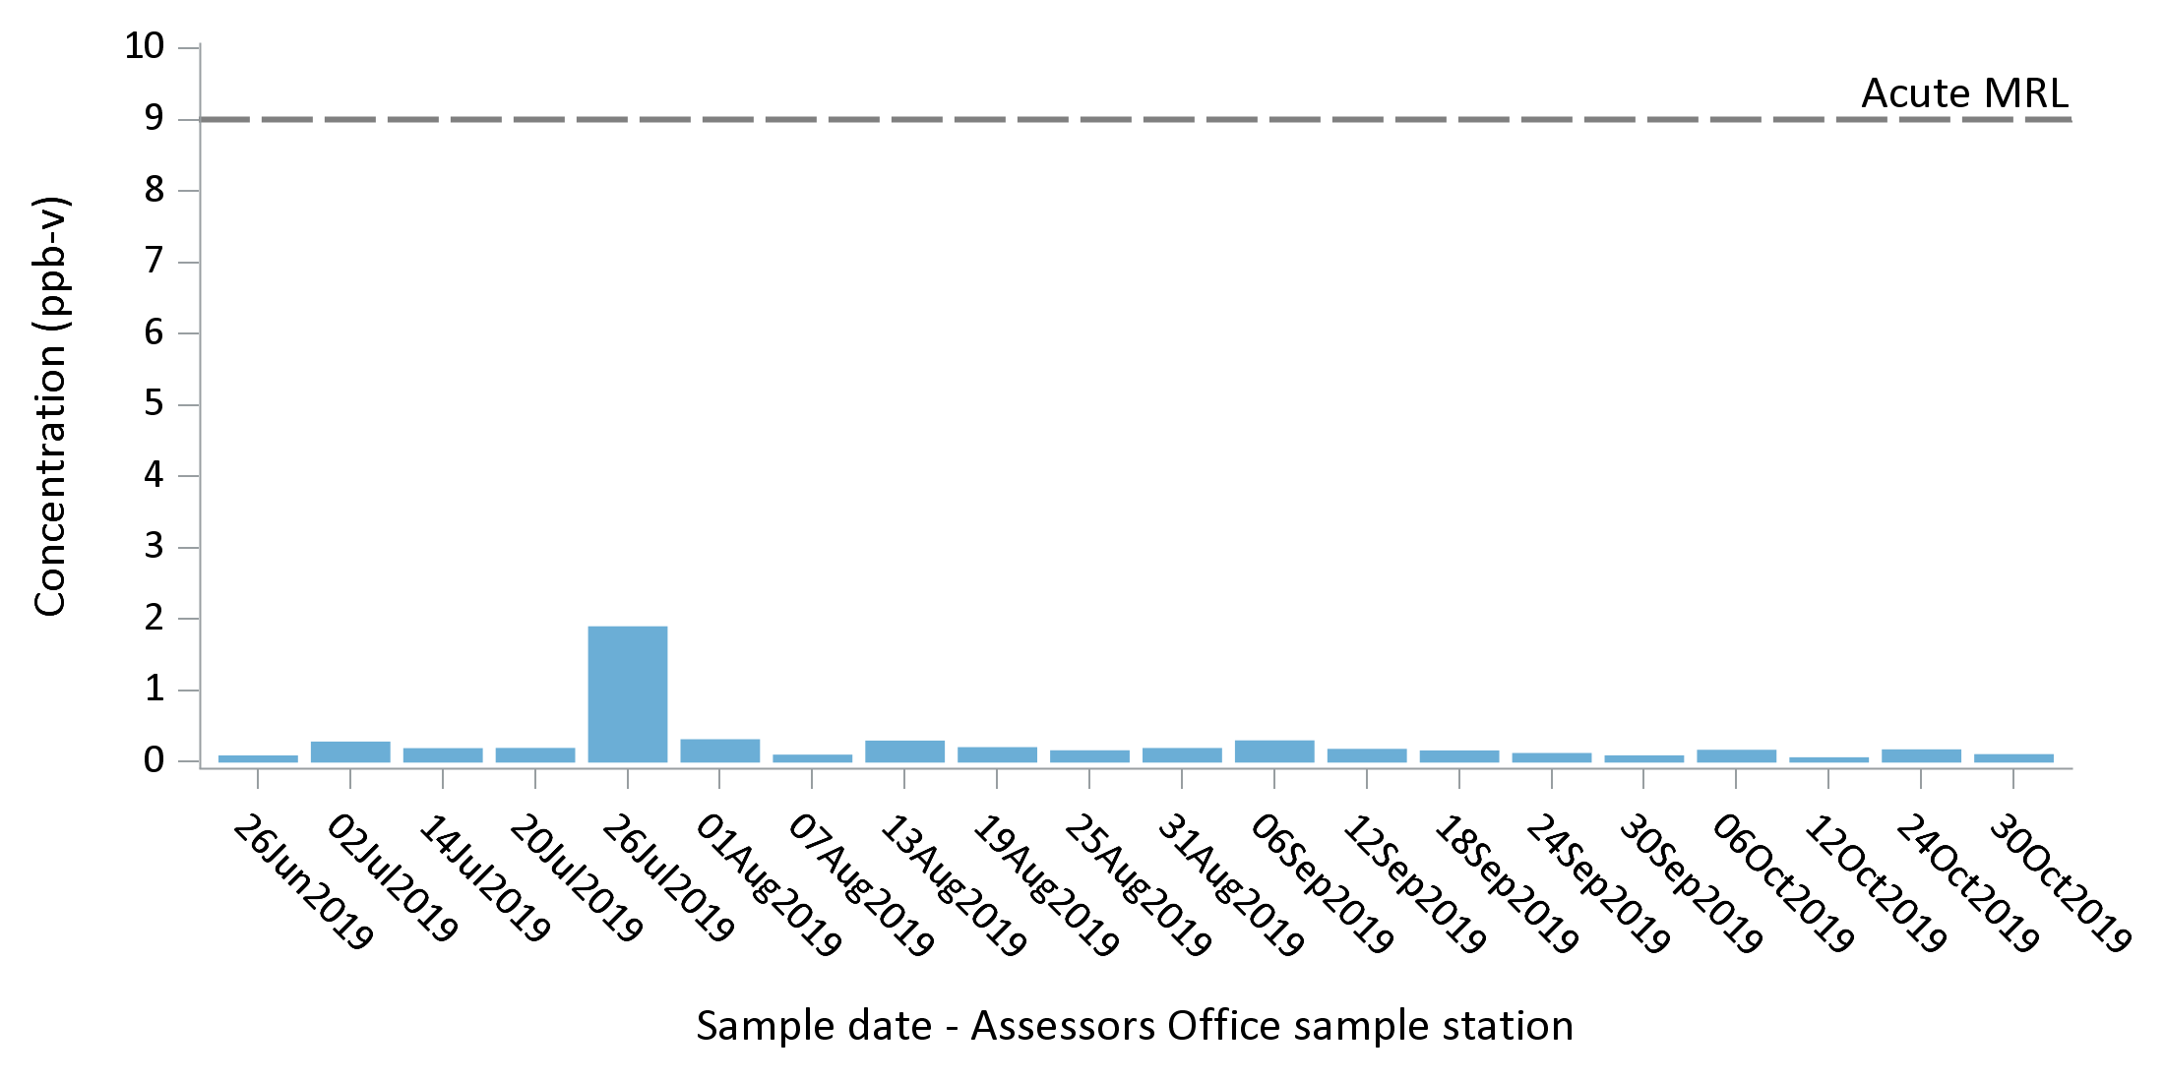
EXAMPLE - Benzene
Comparison of 24-hour sampling results for Benzene to an acute health guideline
Maine CDC - 14

Slide 15
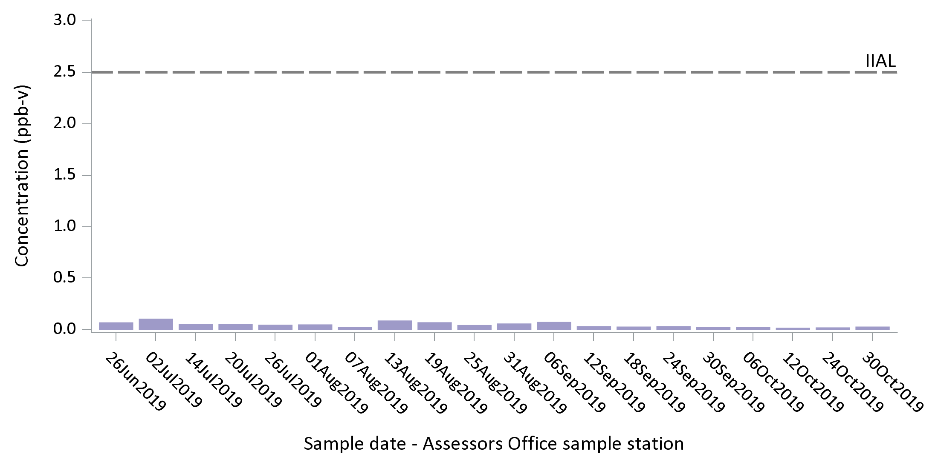
EXAMPLE - Naphthalene
Comparison of 24-hour sampling results for Naphthalene to an acute health guideline
Maine CDC - 15

Slide 16
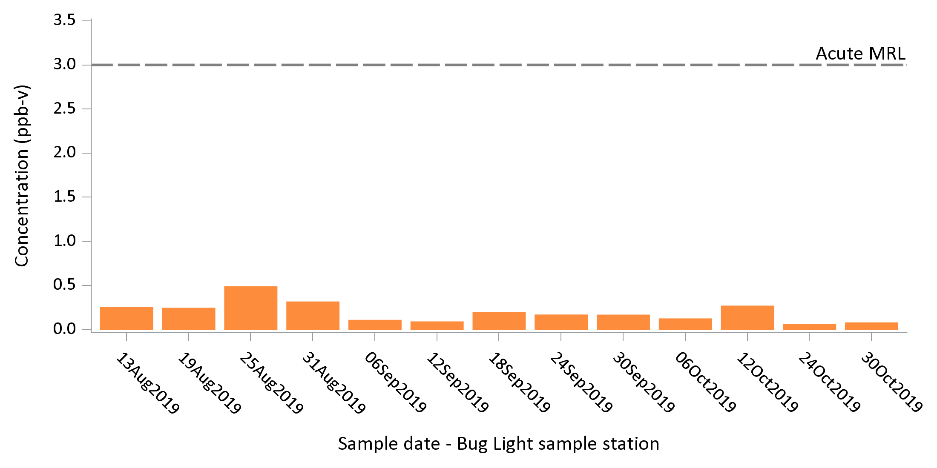
EXAMPLE - Acrolein
Comparison of 24-hour sampling results for Acrolein to an acute health guideline
Maine CDC - 16

Slide 17
How we assess long-term exposure to chemicals in outside air:
For each location and for each 24-hour sampling event and each specific chemical result…
Compute the average air level
Maine AAGs (EPA)
ATSDR Chronic MRLs
Day 1 → 24-hr sample → Benzene
Day 6 → 24-hr sample → Benzene
Day 12 → 24-hr sample → Benzene
Day 18 → 24-hr sample → Benzene
Day 24 → 24-hr sample → Benzene
Day 30 → 24-hr sample → Benzene
Day 36 → 24-hr sample → Benzene
Average
Benzene Concentration in air
Above a
Chronic
Health Guideline
?
Maine CDC - 17

Slide 18
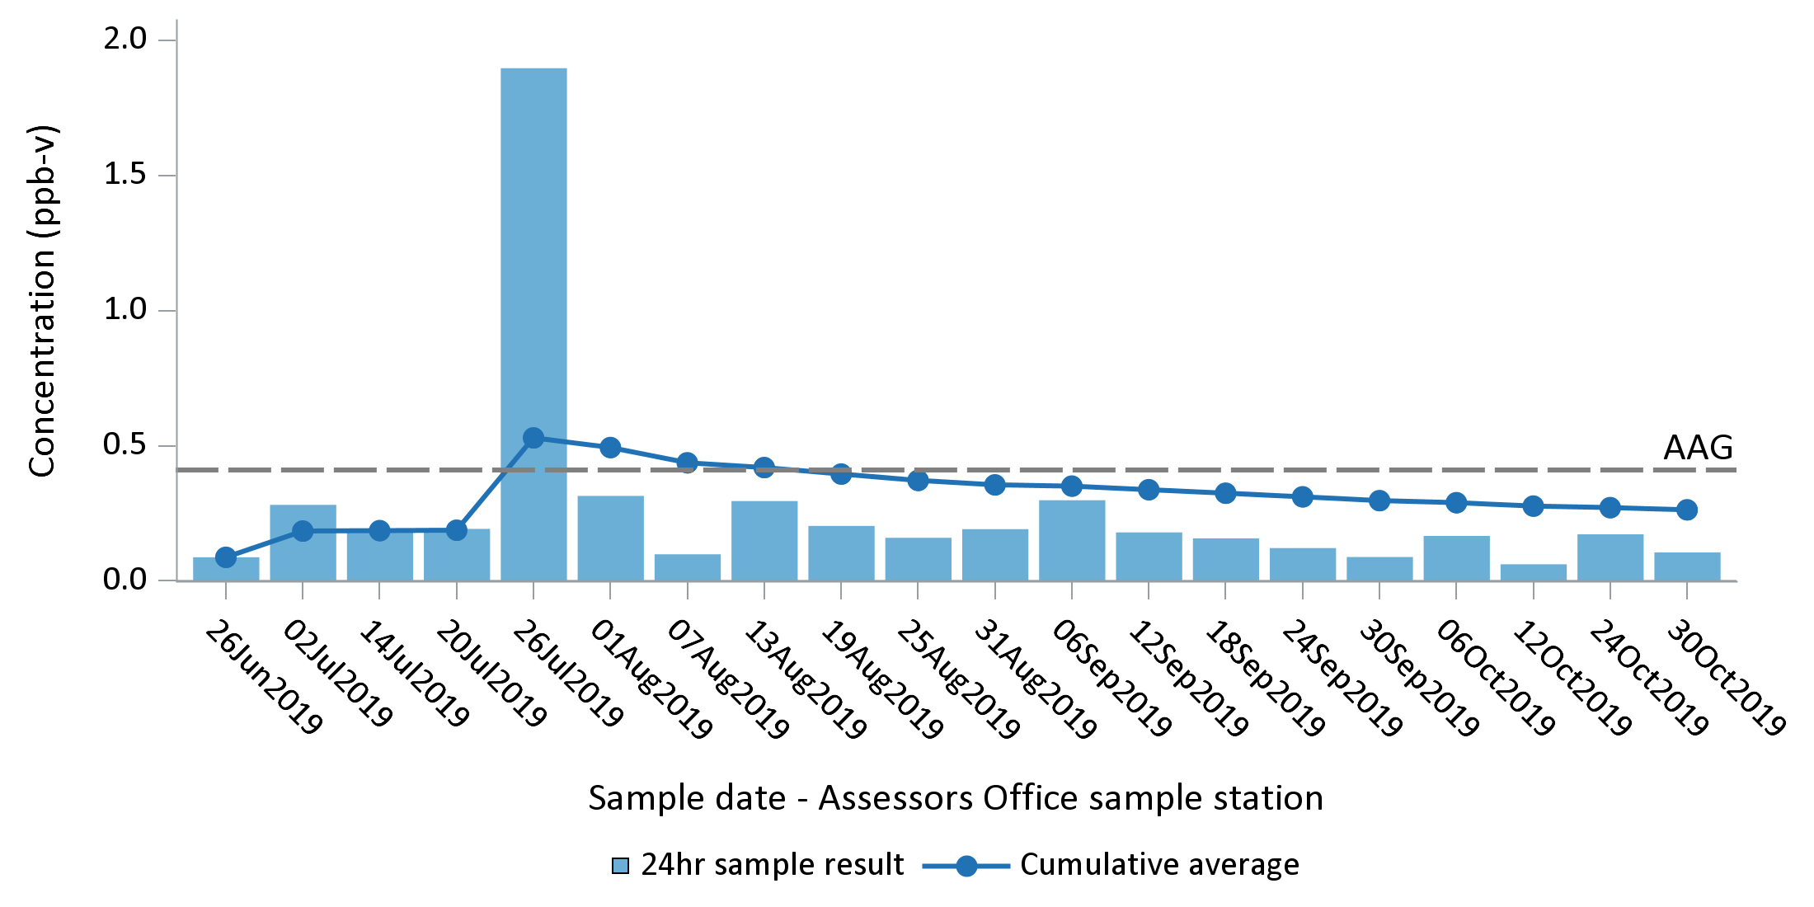
EXAMPLE - Benzene
Averaging of 24-hour sampling results for Benzene and comparison to a chronic health guideline
Maine CDC - 18

Slide 19
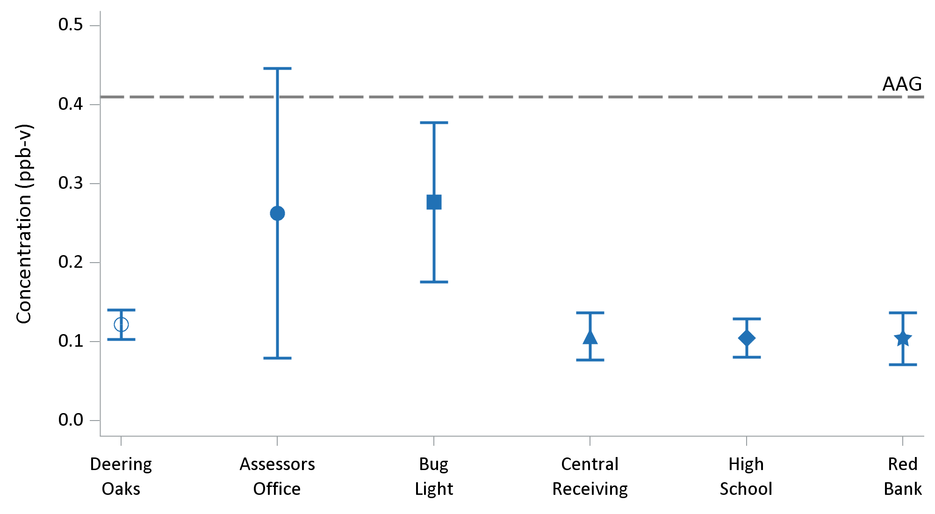
EXAMPLE - Benzene
Comparison of average 24-hour sampling results for Benzene across sampling locations
with 95% confidence interval on the mean
Maine CDC - 19
Notes:
Note, appears typical indoor air levels of benzene average 0.4 – 0.8 ppb, especially influenced by having an attached garage.

Slide 20

EPA’s Derivation of an Chronic Toxicity Value for Benzene (AAG)
10,000+
ppb-years
Assumes Linear
Dose-Response
0.4 ppb
Increase in cancer
in workers (leukemia)
Incremental Lifetime Cancer Risk of
1-in-100,000
Maine CDC - 20
Notes:
Most workers with leukemia had cumulative exposure to benzene of 45 – 1000 ppm-years.

Slide 21
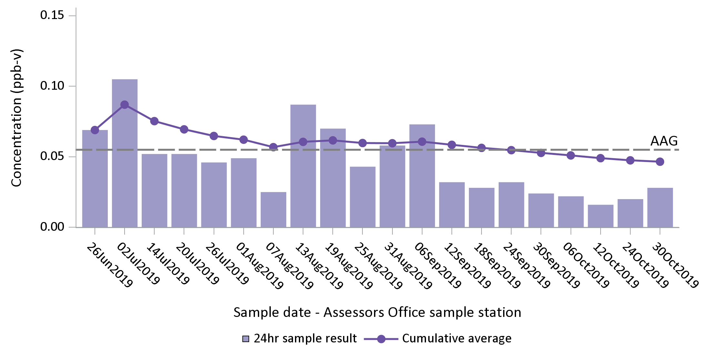
EXAMPLE - Naphthalene
Averaging of 24-hour sampling results for Naphthalene and comparison to a chronic health guideline
Maine CDC - 21

Slide 22
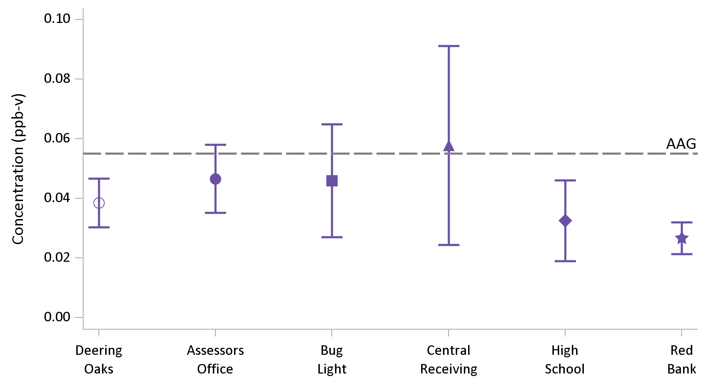
EXAMPLE - Naphthalene
Comparison of average 24-hour sampling results for Naphthalene across sampling locations
with 95% confidence interval on the mean
Maine CDC - 22
Notes:
Note, appears typical indoor air levels of naphthalene are around 0.2 ppb based on study of MI homes, with some homes more than 10-fold higher.

Slide 23

California’s Derivation of an Chronic Toxicity Value for Naphthalene (AAG)
10,000 to 60,000
ppb
Assumes Linear
Dose-Response
0.06 ppb
Increase in
nasal tumors
Incremental Lifetime Cancer Risk of
1-in-100,000
Maine CDC - 23

Slide 24
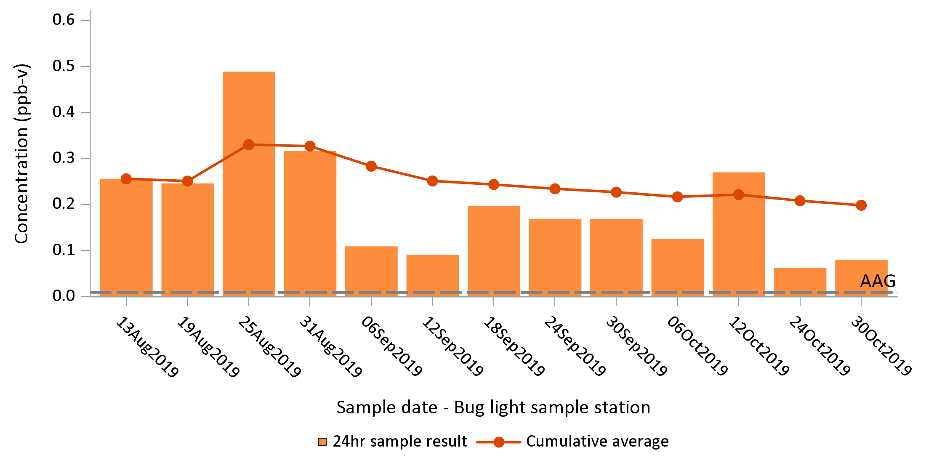
EXAMPLE - Acrolein
Averaging of 24-hour sampling results for Acrolein and comparison to a chronic health guideline
Maine CDC - 24

Slide 25
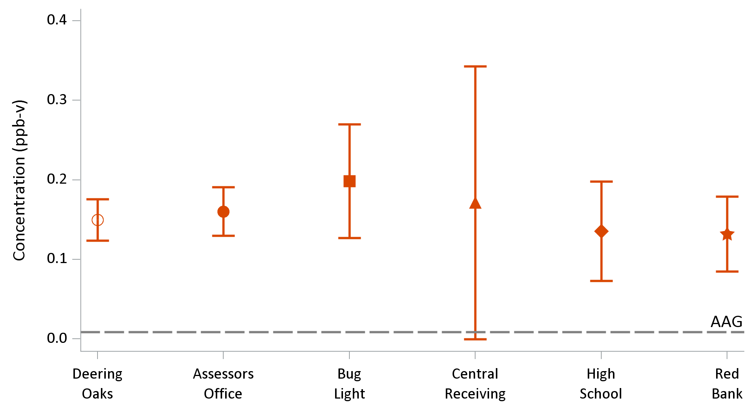
EXAMPLE - Acrolein
Comparison of average 24-hour sampling results for Acrolein across sampling locations
with 95% confidence interval on the mean
Maine CDC - 25
Notes:
Note, appears typical indoor air levels of acrolein are around 0.26 ppb for urban locations, and can be much higher if frequent cooking with heated fats.

Slide 26
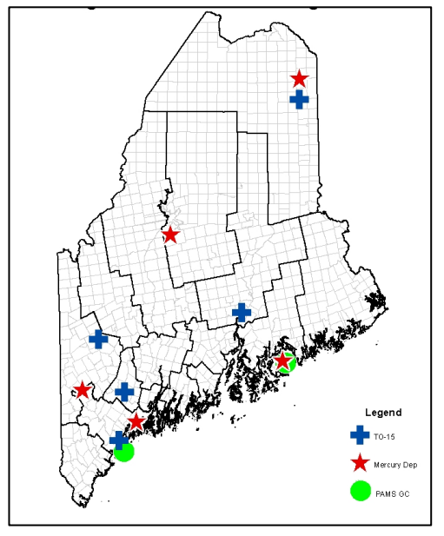
2018 HAPs Data – Acrolein Annual Averages
0.32 ppb
0.17 ppb
0.19 ppb
0.20 ppb
0.20 ppb
0.21 ppb
Maine CDC - 26
Source: Maine DEP Air Bureau (2019)
Notes:
Note: checked DEP qualifiers and few acrolein results have qualifiers. Also, annual averages fairly similar for 2016-2018 for Presque Isle

Slide 27
EPA’s Derivation of a Chronic Toxicity Value for Acrolein
400 ppb
Rodent to Human,
LOAEL to NOAEL Conversions
Protection of Sensitive Individuals
0.1 ppb
0.01ppb
Nasal lesions
(LOAEL)
Human Equivalent NOAEL Dose
Dose that is “safe” for sensitive members of the population
~4000x
10x
Maine CDC - 27
Notes:
Feron et al. (1978) exposed 6 Wistar rats/sex/concentration, 10 Syrian golden hamsters/sex/concentration, and 2 Dutch rabbits/sex/concentration for 6 hr/day, 5 days/week for 13 weeks to 0, 0.4, 1.4, or 4.9 ppm (0, 0.9, 3.2, or 11 mg/m3 ) acrolein in a whole-body exposure chamber.
Adjust animal LOAEL 6/24 x 5/7 x 0.14 (A-H inhalation dosimetric adjustment). Then 3x for additional animal to human and 3x for LOAEL to NOAEL, 10x for subchronic to chronic, and 10x average human to sensitive human.

Slide 28
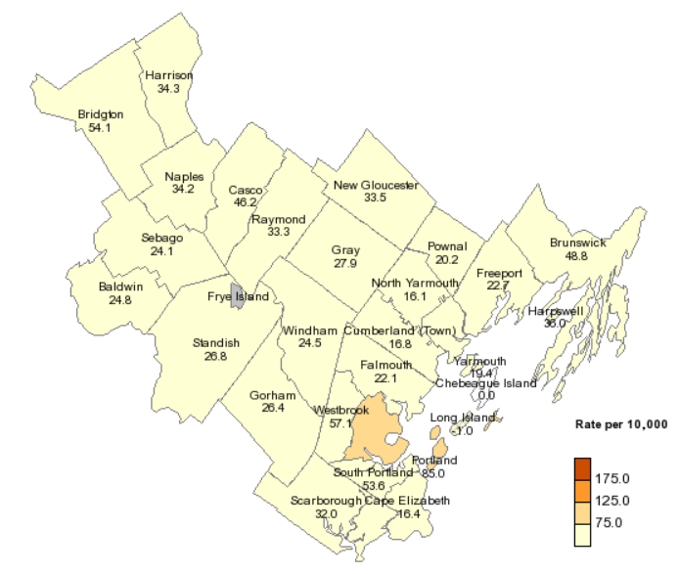
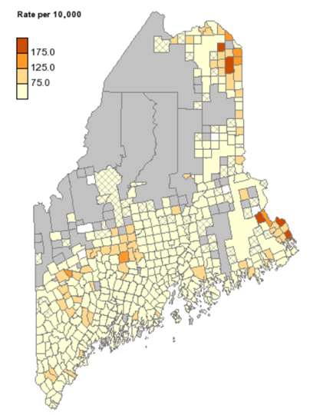
Evaluate Health Outcomes - Asthma
Rates of Emergency Department Visits by Town
Cumberland County 2010-2014
Rates of Emergency Department Visits by Town
Statewide 2010-2014
Maine CDC - 28
Source: https://data.mainepublichealth.gov/tracking/

Slide 29
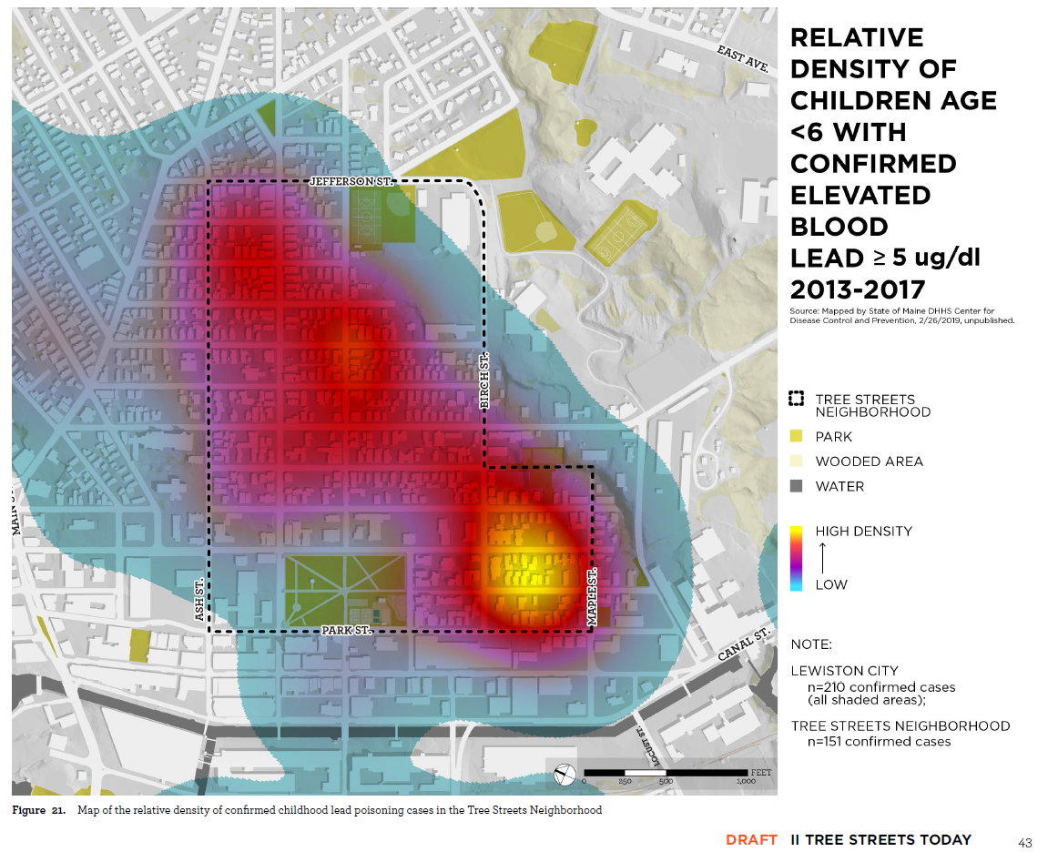
Potential Cluster Analysis
Example – Childhood Lead Poisoning
Maine CDC - 29

Slide 30
Next Steps for Maine CDC
Continue to monitor 24-hour sampling results in partnership with DEP
Continue to track cumulative averages for each location in partnership with DEP
Obtain and evaluate data on asthma ED visits for Portland / South Portland
Periodically report back to South Portland community
Maine CDC - 30

Slide 31
Questions?
Andrew Smith, SM, ScD
State Toxicologist
Maine Center for Disease
Control and Prevention
andy.e.smith@maine.gov

